Slide 1
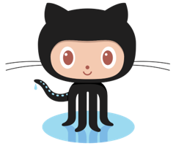
Introduction to github

Slide 2
What is open source software development
Open source software is software with source code that anyone can inspect, modify, and enhance.
By design, open source software licenses promote collaboration and sharing because they permit other people to make modifications to source code and incorporate those changes into their own projects. They encourage computer programmers to access, view, and modify open source software whenever they like, as long as they let others do the same when they share their work.

Slide 3
The "Git" in Github
Git is an open-source version control system that was started by Linus Trovalds—the same person who created Linux.
Git is a version control system
Git is the preferred version control system of most developers, since it has multiple advantages over the other systems available. It stores file changes more efficiently and ensures file integrity better.

Slide 4
The "Hub" in Github
Git is a command-line tool, but the center around which all things involving Git revolve is the hub—GitHub.com—where developers store their projects and network with like minded people.

Slide 5
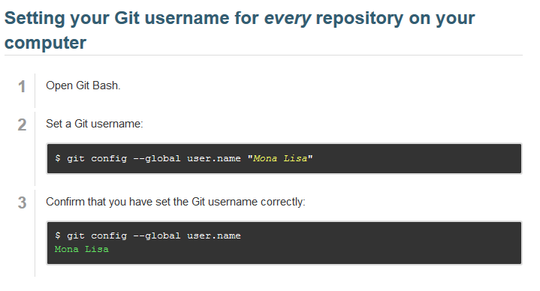
Installing git and configuring
To use Git on the command line, you'll need to download, install, and configure Git on your computer.
Setting your Git username for every repository on your computer

Slide 6
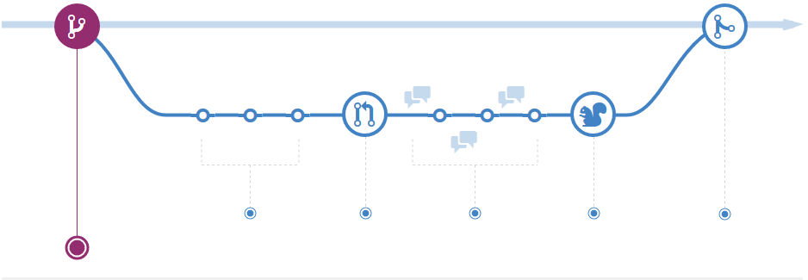
Branches
A branch in Git is simply a lightweight movable pointer to one of these commits. The default branch name in Git is master. As you initially make commits, you're given a master branch that points to the last commit you made. Every time you commit, it moves forward automatically.

Slide 7
Create a repository
To put your project up on GitHub, you'll need to create a repository for the project to live in.
Commit your first change
A commit is like a snapshot of all the files in your project at a particular point in time.

Slide 8
FORK a repository
A fork is a copy of a repository. Forking a repository allows you to freely experiment with changes without affecting the original project.
Most commonly, forks are used to either propose changes to someone else's project or to use someone else's project as a starting point for your own idea.

Slide 9
Pull request
Pull Requests are the heart of collaboration on GitHub. When you open a pull request, you’re proposing your changes and requesting that someone review and pull in your contribution and merge them into their branch.
Pull requests show diffs, or differences, of the content from both branches. The changes, additions, and subtractions are shown in green and red.

Slide 10
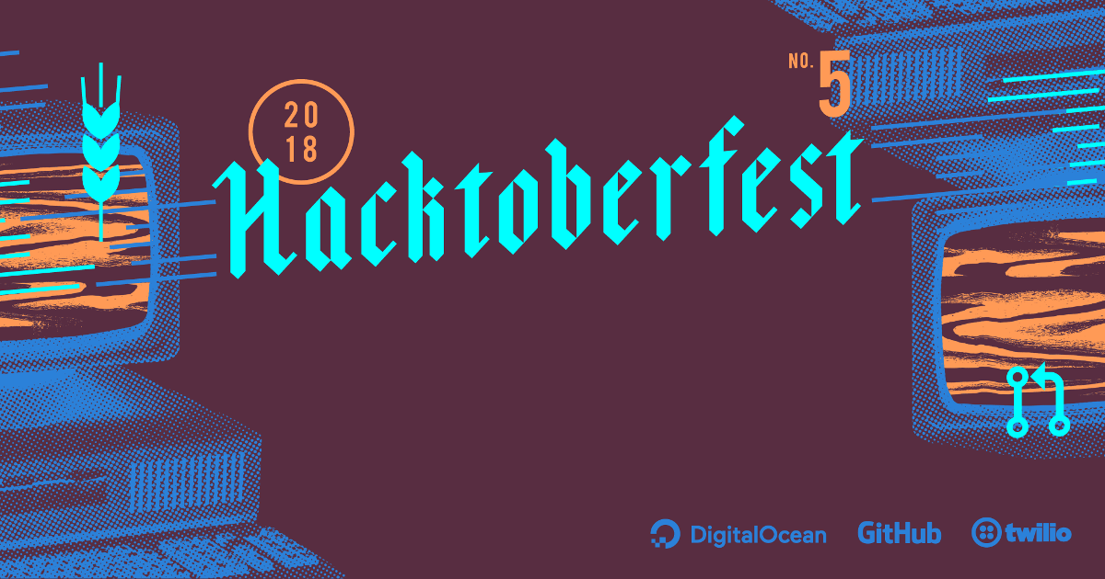
hacktoberfest
Hacktoberfest is all about encouraging meaningful contributions to the open source ecosystem, for beginners and veterans alike.
It's is conducted my a lot of big companies to promote open source development.

